Slide 1
POSSIBLE LOCATIONS FOR AFRICAN RESTAURANT IN TORONTO

Slide 2
Background
Toronto is a major Canadian commercial city
large population with significant African migrant.
African residents are projected to increase significantly
increase in demand for African dishes.

Slide 3
Problem
Data needed for this project are:
Their location,
the type of restaurant
number of restaurant in a neighborhood.
Foursquare location data
and machine learning to find appropriate neighborhoods in Toronto were new African restaurant can be located.

Slide 4
Who should be Interested?
This project is for those who plan to start restaurant in Toronto.
choice of neighborhood site
Recommending neighborhood with less concentration of restaurants.
guide to the best neighborhood with the possibility of high demands
and high demands for African dishes.

Slide 5
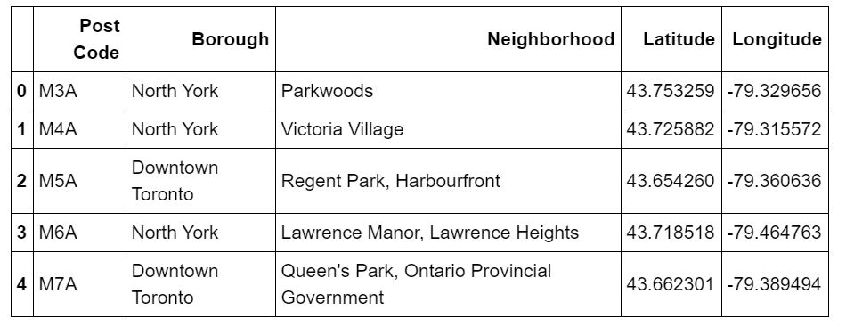
SOME Toronto Borough And Their Latitude And Longitude:

Slide 6
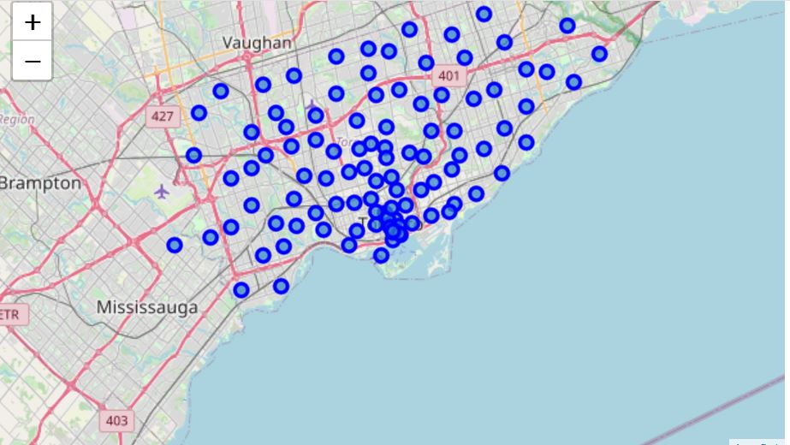
: Map of Toronto Neighborhood

Slide 7
RESULTS AND DISCUSSION
Result analysis :
shows some neighborhood in Toronto have high restaurant distributions while others have little or no restaurant.
Seven neighborhoods were identified to have low restaurant distribution in Downtown Toronto.
Toronto Boroughs have on only two identified African restaurants.

Slide 8
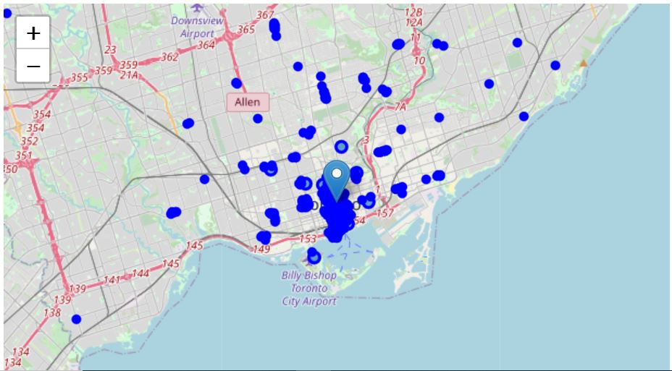
Map of Restaurant Locations in Toronto

Slide 9
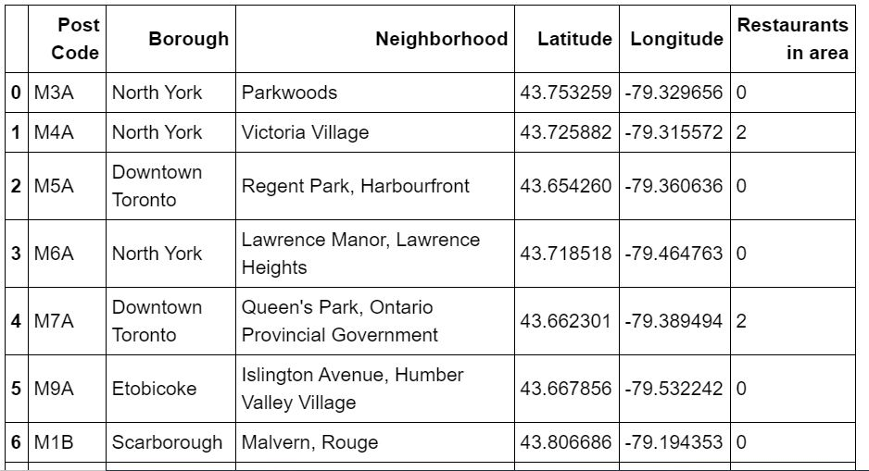
Toronto Borough with low number of Restaurants :

Slide 10
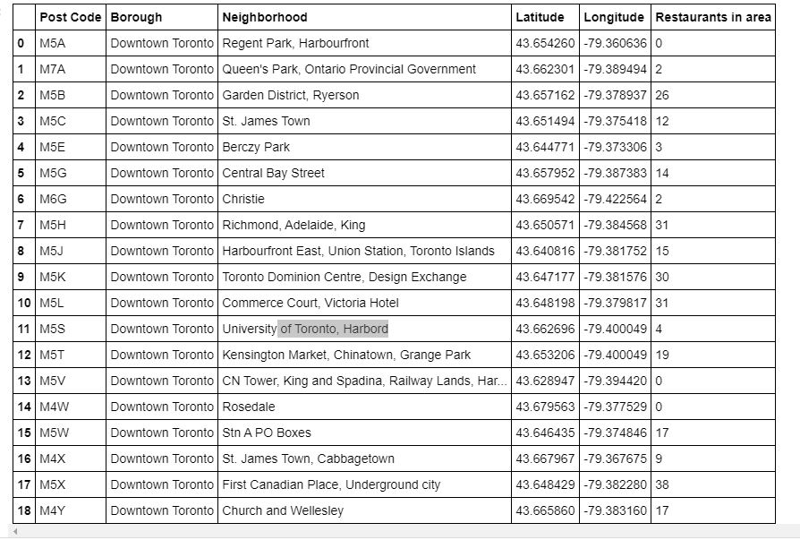
Downtown Toronto Restaurant Distribution

Slide 11
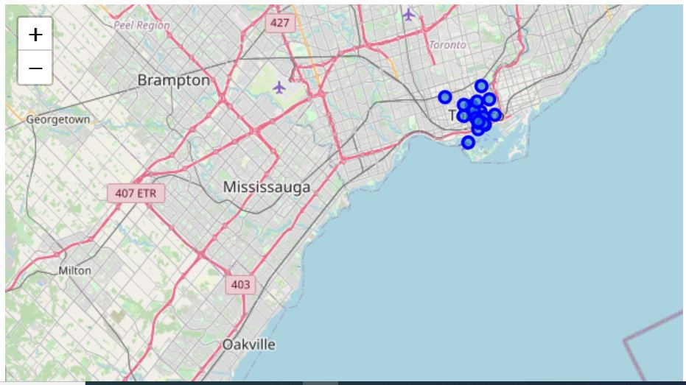
Map of Restaurant clustering in Downtown Toronto

Slide 12
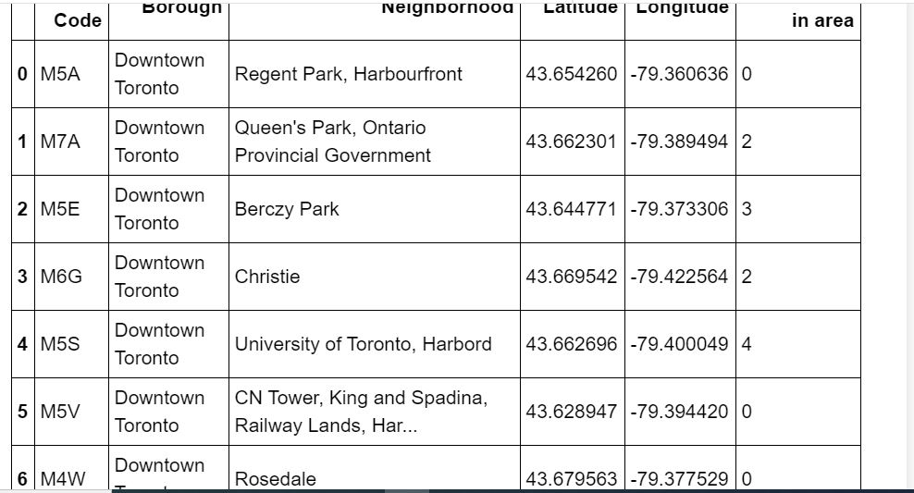
Recommended Neighborhoods for African Restaurant

Slide 13
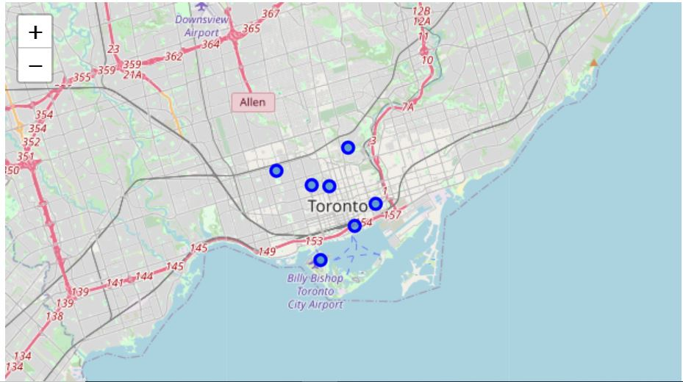
Map of Recommended Locations

Slide 14
CONCLUSION
Purpose of this project was to:
locate borough in Toronto with low number of restaurants
locate an African restaurant.
Foursquare APi was used to identify all the restaurant in Toronto.
The boroughs were then further divided to areas with low and high number of restaurants.
The region of low number of restaurant in Downtown Toronto was further analyzed to identify optimal locations.

Slide 15
Remark
The investor is expected to carry out feasibility studies to determine suitability of recommended locations
The study also showed that Foursquare API may not have adequately identified African Restaurants in Toronto
as search for African restaurant in google identified more than two restaurant Foursquare API returned.
This may be due to bias
or African restaurant in Toronto may have a low standard that made them not to be classified properly.

